Slide 1
Mensuration

Slide 2
Mensuration is the branch of mathematics which deals with the study of Geometric shapes, their area, volume and related parameters.
Learning Outcomes
Through this Topic Candidates should be able to
understand the basic concepts of mensuration
observe the data given and interpret it from the given problem
apply the Concepts to solve Company Specific Aptitude tests
apply the Concepts to solve questions asked in various government exams like SSC CGL, Banking Sector etc.

Slide 3
Contents
2D Figures: Area, Perimeter.
3D Figures: Volume, Curved surface Area and Total surface Area.
2D Figures | 3D Figures
Rectangle | Cuboid
Square | Cube
Triangle | Cylinder
Circle | Cone
Parallelogram | Sphere
Trapezium | Hemisphere

Slide 4
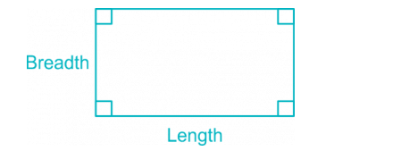
2D Figures:
Rectangle
Area of Rectangle = Length × Breadth.
Perimeter of a Rectangle = 2 × (Length + Breadth)
Length of the Diagonal = √(Length² + Breadth² )

Slide 5
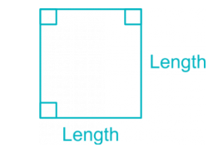
Square
Area of a Square = Length × Length = (Length)²
Perimeter of a square = 4 × Length
Length of the Diagonal = √2 × Length

Slide 6
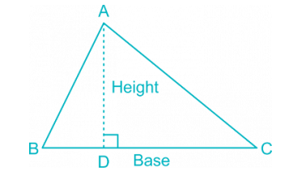

Triangle

Slide 7
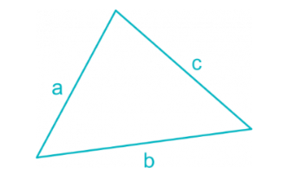
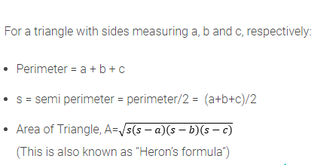
Triangle

Slide 8
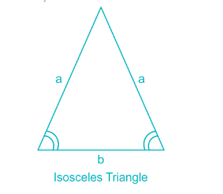

Isosceles Triangle
Area of Isosceles Triangle:
(Where a = length of two equal side, b = length of base of isosceles triangle.)

Slide 9
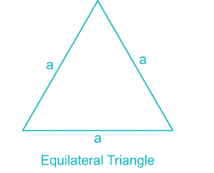

Equilateral Triangle
Area of Equilateral Triangle

Slide 10
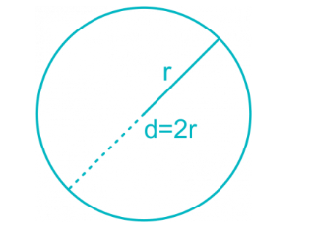
Circle & Semicircle
Area of a circle = πr² = 𝜋d²/4
Circumference of a circle = 2πr = πd
Circumference of a semicircle = πr + 2r
Area of semicircle = 𝜋r²/2
(In the following formulae, r = radius and d = diameter of the circle)

Slide 11
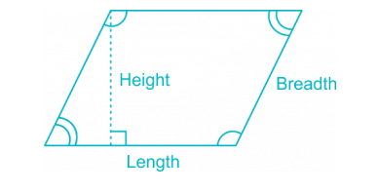
Parallelogram
Area of a Parallelogram = Length × Height
Perimeter of a Parallelogram = 2 × (Length + Breadth)

Slide 12
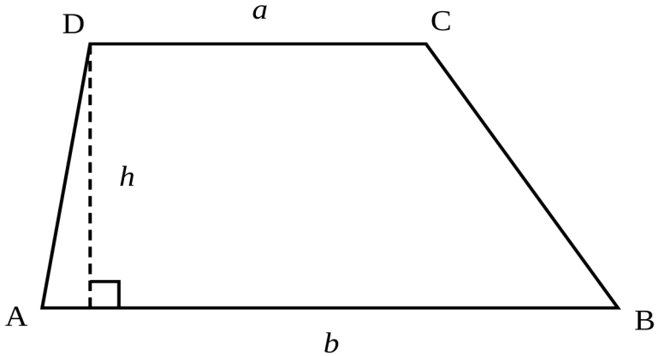
Trapezium
Area of a trapezium =(1/2)× sum of parallel sides × distance between parallel sides

Slide 13
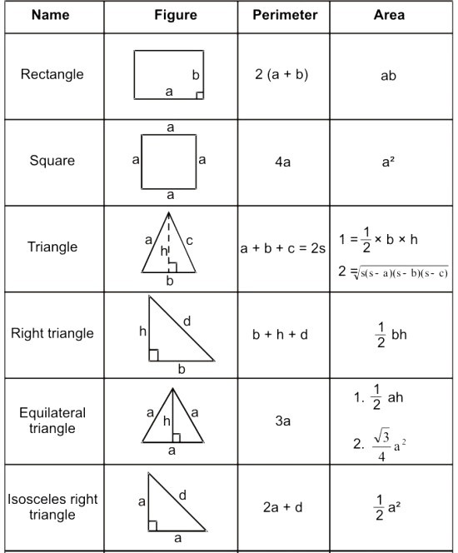

Slide 14
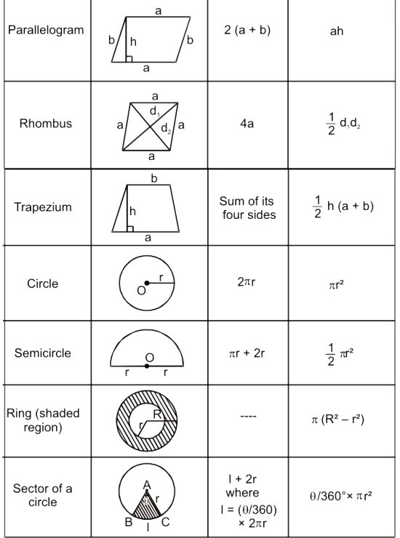

Slide 15
Practice Questions

Slide 16
If the Length of the diagonal AC of a square ABCD is 5.2 cm, then the area of the square is:
(a) 15.12 sq. cm
(b) 13.52 sq. cm
(c) 12. 62 sq. cm
(d) 10.00 sq. cm
Ans. B

Slide 17
2. The difference between the length and breadth of a rectangle is 23 m. If its perimeter is 206 m, then its area is
1520 cm²
2420 m²
(c) 2480 cm²
(d) 2520 m²
Ans. D

Slide 18
3. A cow is tied on the corner of a rectangular field of size 30m*20m by a 14 m
long rope. The area of the region that she can graze is
350 sq. m
196 sq. m
154 sq. m
22 sq. m
Ans. C

Slide 19
4. The area (in m²) of the square which has the same perimeter as a rectangle whose length is 48 m and is 3 times its breadth is;
1000
(b) 1024
(c) 1600
(d) 1042
Ans. B

Slide 20
5. There is a rectangular tank of lenght 180 m and breadth 120 m in a circular field, If the area of the land portion of the field is 40000 m², what is the radius of the field? (Take π = 22/7)
(a)130 m
(b) 135 m
(c)140m
(d)145m
Ans. C

Slide 21
6. A wire when bent in the form of a square encloses an area of 484 sq. What will be the enclosed area when the same wire is bent into the form of a circle?
(Take π= 22/7)
150 cm ²
(b) 230 cm²
(c) 550 cm²
(d) 616 cm²
Ans. D

Slide 22
7. The diagonal of a square of another is 4 /2 cm. The diagonal of another square whose area is double that of the first square is:
8√2 cm
16cm
√32 cm
8 cm
Ans. D

Slide 23
8. Between a square of perimeter 44 cm and a circle of circumference 44 cm which figure has larger area and by how much?
(a) Square, 33 cm²
(b) Circle, 33 cm²
(c) Both have equal area.
(d) square, 495 cm²
Ans. B

Slide 24
9. A vertical stick 15m long casts a shadow 12m long on the ground. At the same time, a tower casts a shadow 50m long on the ground. The height of the tower is
60 m
(b) 62 m
(c) 62.5 m
(d) 63 m
Ans. C

Slide 25
10. Four circles having equal radii are drawn with centres at the four corners of a square. Each circle touches the other two adjacent circle. If remaining area of the square is 168 cm square, what is the size of the radius of the circle?
A. 1.4 cm
B. 14 cm
C. 35 cm
D. 21 cm
Ans. B

Slide 26
11. The radius of a circular field is equal to the side of a square field. If the difference between the perimeter of the circular field and that of the square field is 32m, what is the perimeter of the square field?
84m
95m
56m
28m
Ans. C

Slide 27
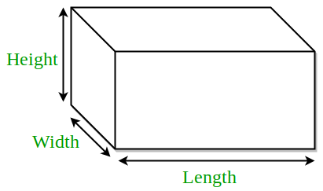
3D Figures:
Cuboid
Let
l= length
b= breadth
h= height. Then,
Volume = (l x b x h) cubic units.
Lateral Surface area = 2( b + l) h sq. units.
Surface area = 2(lb + bh + lh) sq. units.
Diagonal = √(l² + b² + h² ) units.

Slide 28
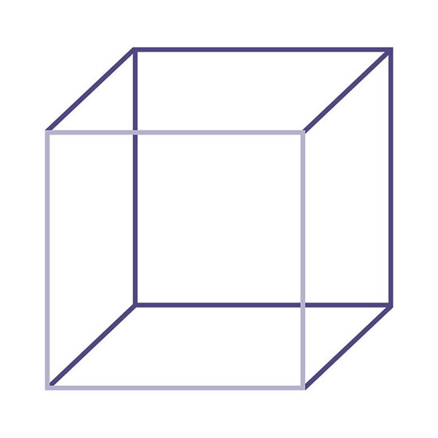
Cube
a
a
Let each edge of a cube be of length a. Then,
Volume = a³ cubic units.
Lateral Surface area = 4a² sq. units
Surface area = 6a² sq. units.
Diagonal = √3a units.
a

Slide 29
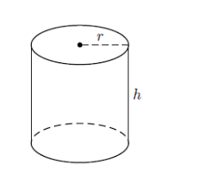
Cylinder
Let radius of base = r and Height (or length) = h. Then,
Volume = (пr²h) cubic units.
Curved surface area = (2пr h) sq. units.
Total surface area = 2 п r(h + r) sq. units.

Slide 30
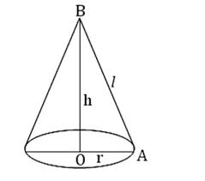
Cone
Let radius of base = r and Height = h. Then,
Slant height, l = √h² + r² units.
Volume = (1/3) п r²h cubic units.
Curved surface area = (п rl) sq. units.
Total surface area = (п rl + п r²) sq. units.

Slide 31
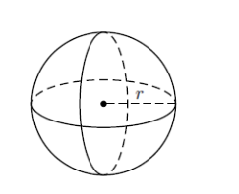
Sphere
Let the radius of the sphere be r. Then,
Volume = (4/3) п r³ cubic units.
Surface area = (4 п r²) sq. units.

Slide 32
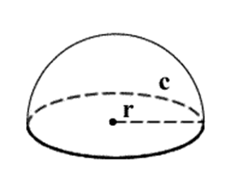
Hemisphere
Let the radius of a hemisphere be r. Then,
Volume = (2/3) п r³ cubic units.
Curved surface area = (2 п r²) sq. units.
Total surface area = (3 п r²) sq. units.

Slide 33
Practice Questions

Slide 34
A cuboidal water tank has 216 liters of water. Its depth is 1/3 of its length and breadth is 1/2 of 1/3 of the difference of length and depth. The length of the tank is
72dm
18dm
6dm
2dm
Ans. B

Slide 35
2. A cuboidal block of 6 cm x 9 cm x 12 cm is cut upinto exact number of equal cube. The least possible number of cubes will be
6
9
24
30
Ans. C

Slide 36
3. The longest rod that can be placed in a room which is 12m long, 9m broad and 8m high is
27m
17m
23m
13m
Ans. C

Slide 37
4. Three solid iron cubes of edges 4 cm, 5 and 6 cm are melted together to make a new cube. 62 cm³ of the melted material is lost due to improper handing. The are (in cm²) of the whole surface of the newly formed cube is
294
(b) 343
(c) 125
(d) 216
Ans. A

Slide 38
5. A hall is 15 m long and 12 m broad. If the sum of the areas of the floor and the ceiling is equal to the sum of the areas of four walls, the volume of the hall is:
A) 720
B) 900
C) 1200
D) 1800
Ans. C

Slide 39
6. How many bricks each measuring 25cm x 11.25cm x 6cm, will be needed to build a wall 8m x 6m x 22.5m
A) 5600
B) 600
C) 6400
D) 7200
Ans. C

Slide 40
7. A large solid sphere of diameter 15 m is melted and recast into several small spheres of diameter 3 m. What is the percentage increase in the surface area of the smaller spheres over that of the large sphere?
A. 200%
B. 400%
C. 500%
D. can’t be determined
Ans. B

Slide 41
8. Three solid spheres of radius 3 cm, 4 cm and 5 cm are melted and recasted into a solid sphere. What will be the percentage decrease in the surface area?
A) 12
B) 14
C) 16
D) 28
Ans. D

Slide 42
9. A cone, a hemisphere and cylinder have equal bases. If the heights of the cone and a cylinder are equal and are same as the common radius, then find the ratio of their respective volumes.
a)1 : 2 : 3
b)1 : 3 : 2
c)1 : 2 : 1
d)None of the above
Ans. A

Slide 43
10. The height of a right circular cone is trisected by two planes parallel to its base at equal distances. The volumes of the three solids, so obtained, starting from the top, are in the ratio:
a)1 : 8 : 28
b)1 : 7 : 28
c)1 : 7 : 19
d)None of the above
Ans. C

Slide 44
